Slide 1


ROC CURVE
An ROC curve (receiver operating characteristic curve) is a graph showing the performance of a classification model at all classification thresholds. This curve plots two parameters:
True Positive Rate
False Positive Rate
OR
Precision
Recall
True Positive Rate (TPR) is a synonym for recall and is therefore defined as follows:
False Positive Rate (FPR) is defined as follows:

Slide 2
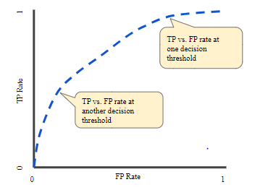
ROC CURVE
An ROC curve plots TPR vs. FPR at different classification thresholds. Lowering the classification threshold classifies more items as positive, thus increasing both False Positives and True Positives. The following figure shows a typical ROC curve.
Figure 4. TP vs. FP rate at different classification thresholds.
To compute the points in an ROC curve, we could evaluate a logistic regression model many times with different classification thresholds, but this would be inefficient. Fortunately, there's an efficient, sorting-based algorithm that can provide this information for us, called AUC.

Slide 3
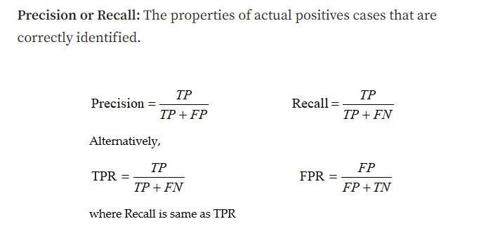
ROC CURVE
Given the confusion matrix, it is easy to construct a point in ROC or Precision-Recall spaces. In the ROC space, False Positive Rate (FPR) is plotted on the x-axis and the True Positive Rate (TPR) is plotted on the y-axis.
The FPR is the ratio of misclassified samples (false positives) to total negatives samples(false positives + true negatives). In simple words, when the answer is actually no, how many times the answer is reported as yes.
The TPR is the ratio of correctly classified samples (true positive) to total positive samples (true positive + false negatives). In simple words, when the answer is yes, how many times the answer is reported as yes.
Recall is plotted on the x-axis, and Precision is plotted on the y-axis. The recall is the same as TPR and Precision is the ratio of truly classified samples (true positives) to the total positive samples. In other words, precision is if the answer is positive, how often it is reported as positive.
Precision and recall are two evaluation metrics used to measure the performance of a classifier in binary and multiclass classification problems.
Precision measures the accuracy of positive predictions, while recall measures the completeness of positive predictions.
A high precision means that there are few false positives, while a high recall means that there are few false negatives.

Slide 4
ROC CURVE

Slide 5
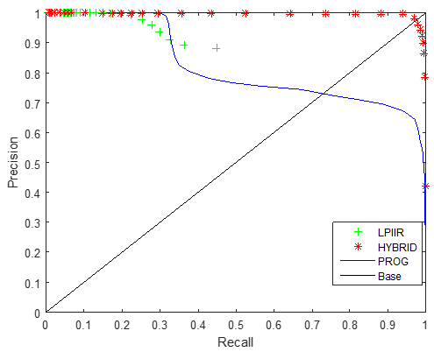
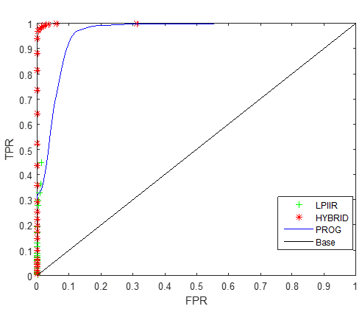
ROC CURVE
Comparison of Three background subtraction algorithms: ROC curve for the three background subtraction techniques including Low Pass Infinite Impulse Response filter, Progressive generation, and Hybrid techniques is shown in Figure 2. It is evident that hybrid techniques have high precision and high recall as compared to the other two methods.
Alternative illustration of the same results can be read in Figure 3 which shows the ROC curve with False positive rate (FPR) against True positive rate (TPR). In this curve TPR is high and FPR is low for our proposed algorithm as compared to the other two published systems.

Slide 6
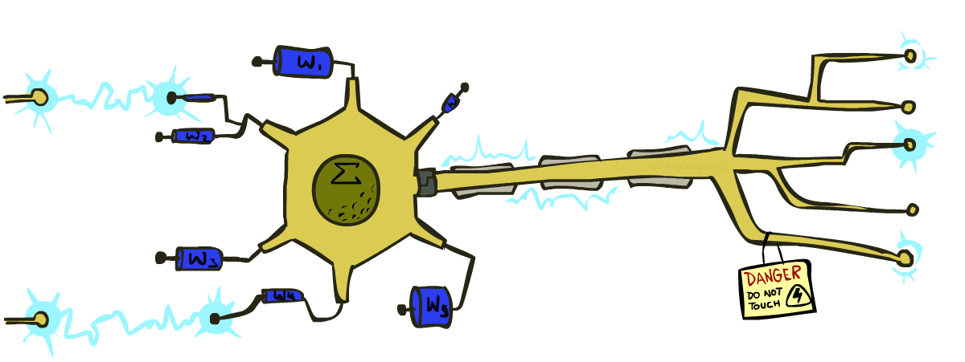
CS 188: Artificial Intelligence
Perceptron
A Perceptron is a neural network unit that does certain computations to detect features or business intelligence in the input data. It is a function that maps its input “x,” which is multiplied by the learned weight coefficient, and generates an output value ”f(x).

Slide 7

Error-Driven Classification

Slide 8
What to Do About Errors
Problem: there’s still spam in your inbox
Need more features – words aren’t enough!
Have you emailed the sender before?
Have 1M other people just gotten the same email?
Is the sending information consistent?
Is the email in ALL CAPS?
Do inline URLs point where they say they point?
Does the email address you by (your) name?
Naïve Bayes models can incorporate a variety of features, but tend to do best in homogeneous cases (e.g. all features are word occurrences)
The naive Bayes classifier assumes that all features in the input data are independent of each other, which is often not true in real-world scenarios. However, despite this simplifying assumption, the naive Bayes classifier is widely used because of its efficiency and good performance in many real-world applications.

Slide 9
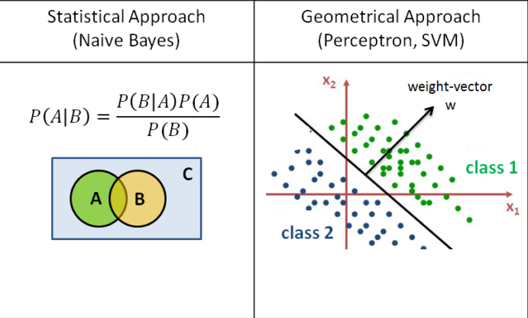
NB vs Perceptron
Perceptron vs. Naive Bayes. Decision Boundary: The perceptron algorithm uses a linear decision boundary to separate the data into classes, while the naive Bayes algorithm uses a probabilistic decision boundary based on the posterior probability of each class.

Slide 10

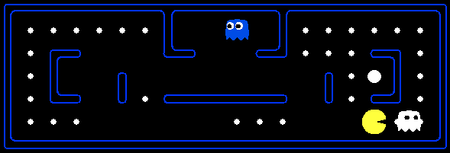
Later On…
Web Search
Decision Problems

Slide 11
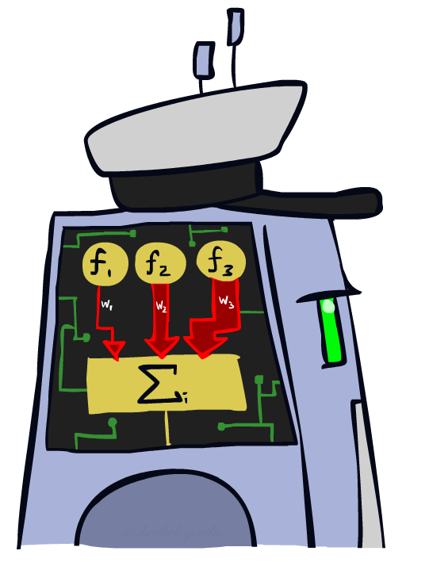
Linear Classifiers

Slide 12
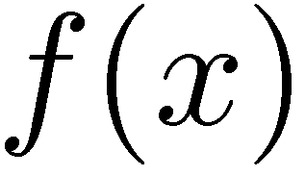

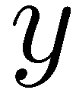

Feature Vectors
Hello,
Do you want free printr cartriges? Why pay more when you can get them ABSOLUTELY FREE! Just
# free : 2
YOUR_NAME : 0
MISSPELLED : 2
FROM_FRIEND : 0
...
SPAM
or
+
PIXEL-7,12 : 1
PIXEL-7,13 : 0
...
NUM_LOOPS : 1
...
“2”

Slide 13

Some (Simplified) Biology
Very loose inspiration: human neurons

Slide 14
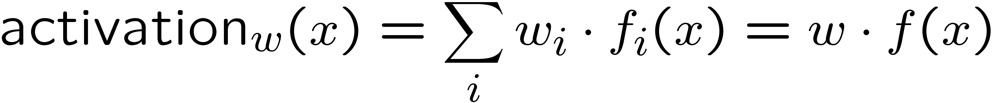
Linear Classifiers
Inputs are feature values
Each feature has a weight
Sum is the activation
If the activation is:
Positive, output +1
Negative, output -1
w₁
f₁
Σ
w₂
>0?
f₂
w₃
f₃

Slide 15

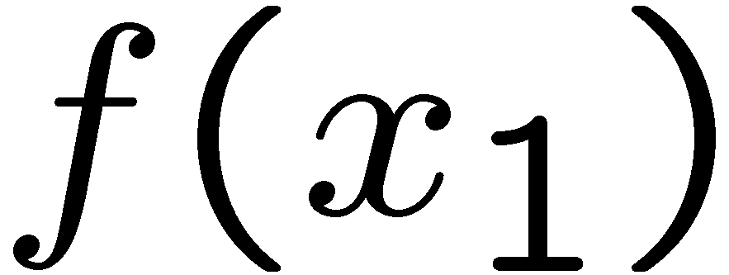
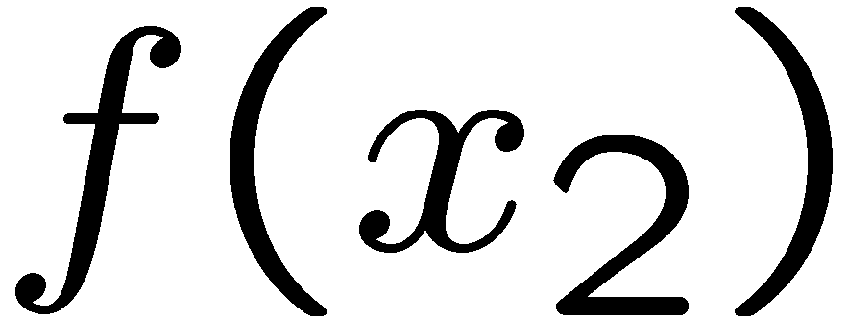
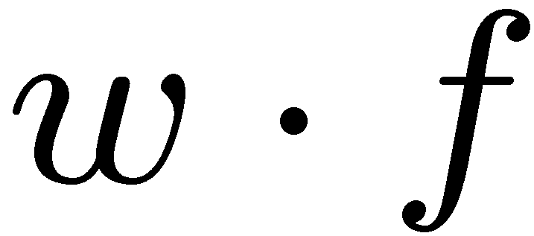
Weights
Binary case: compare features to a weight vector
Learning: figure out the weight vector from examples
# free : 4
YOUR_NAME :-1
MISSPELLED : 1
FROM_FRIEND :-3
...
# free : 2
YOUR_NAME : 0
MISSPELLED : 2
FROM_FRIEND : 0
...
# free : 0
YOUR_NAME : 1
MISSPELLED : 1
FROM_FRIEND : 1
...
Dot product positive means the positive class

Slide 16
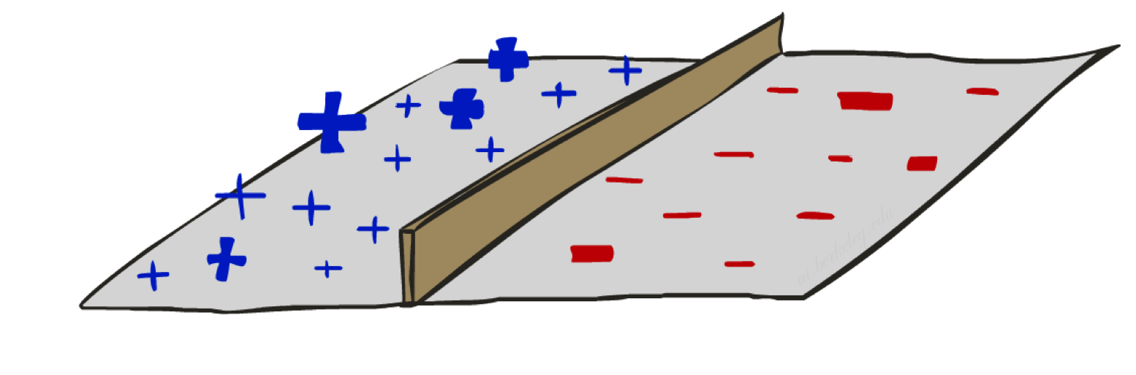
Decision Rules

Slide 17
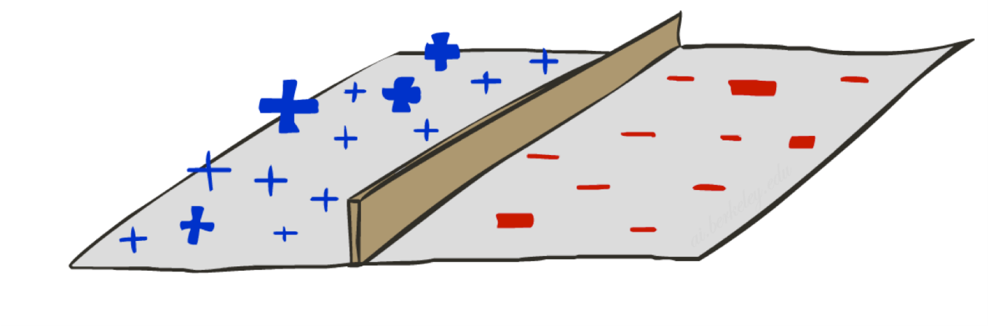

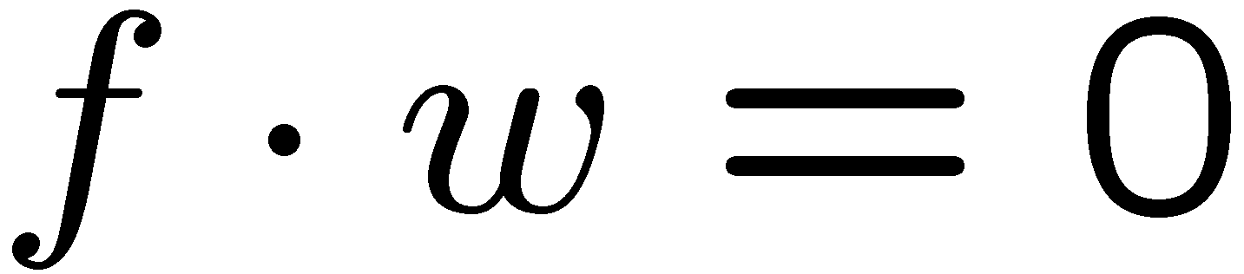
Binary Decision Rule
In the space of feature vectors
Examples are points
Any weight vector is a hyperplane
One side corresponds to Y=+1
Other corresponds to Y=-1
money
2
+1 = SPAM
1
BIAS : -3
free : 4
money : 2
...
0
-1 = HAM
0
1
free

Slide 18

Weight Updates

Slide 19
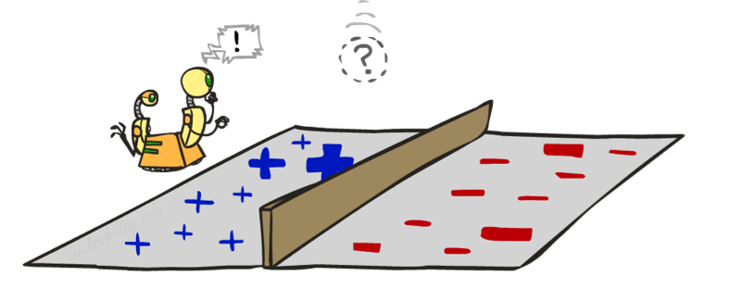
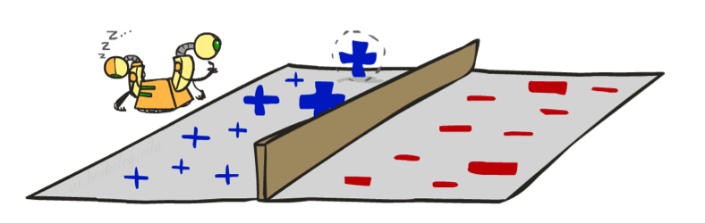
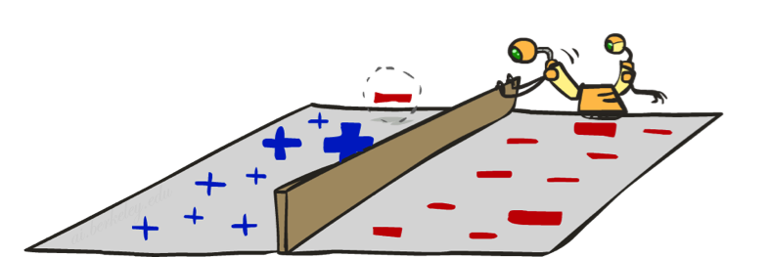
Learning: Binary Perceptron
Start with weights = 0
For each training instance:
Classify with current weights
If correct (i.e., y=y*), no change!
If wrong: adjust the weight vector
Notes:
http://isl.ira.uka.de/neuralNetCourse/2004/VL_11_5/Perceptron.html

Slide 20
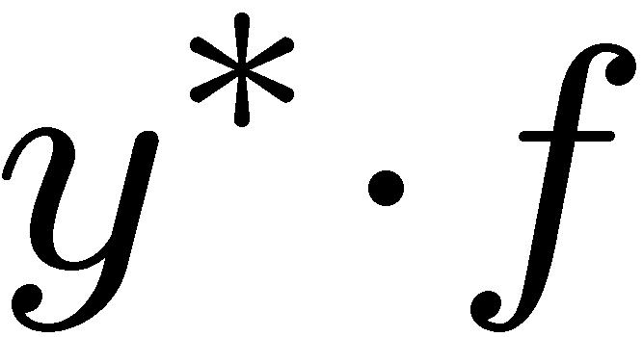
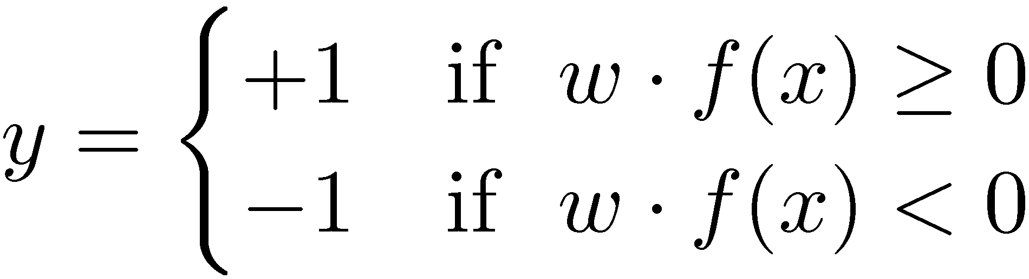

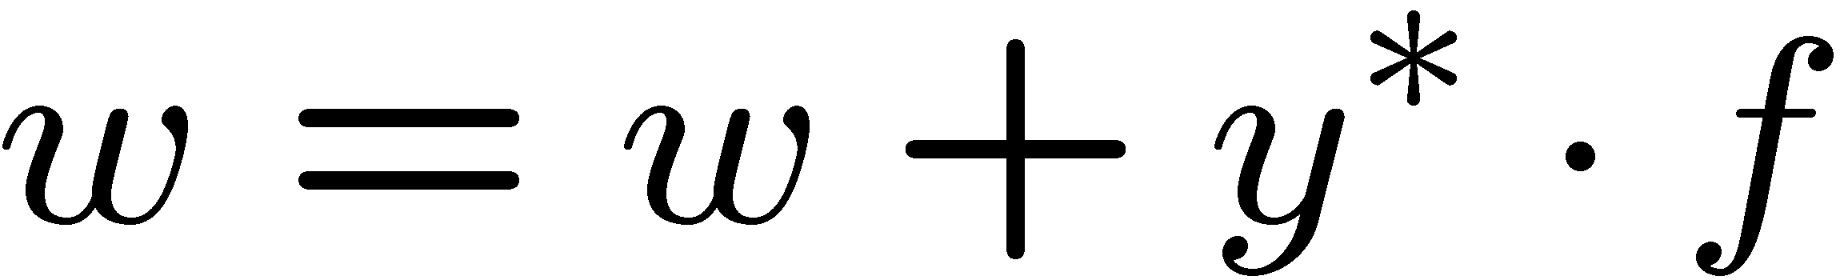
Learning: Binary Perceptron
Start with weights = 0
For each training instance:
Classify with current weights
If correct (i.e., y=y*), no change!
If wrong: adjust the weight vector by adding or subtracting the feature vector. Subtract if y* is -1.
Notes:
http://isl.ira.uka.de/neuralNetCourse/2004/VL_11_5/Perceptron.html

Slide 21
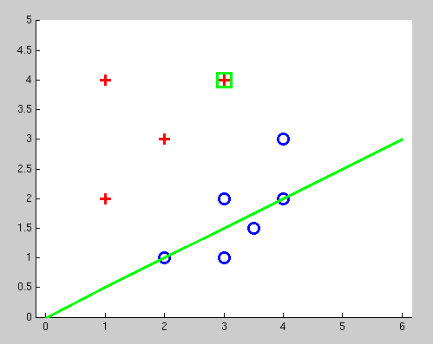
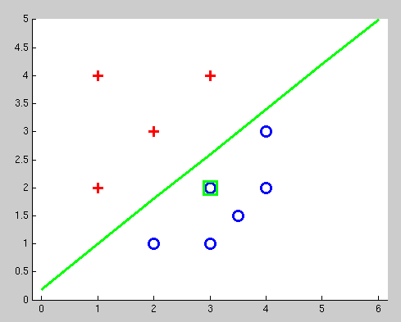
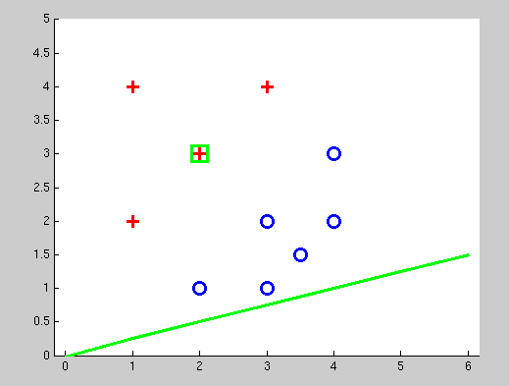
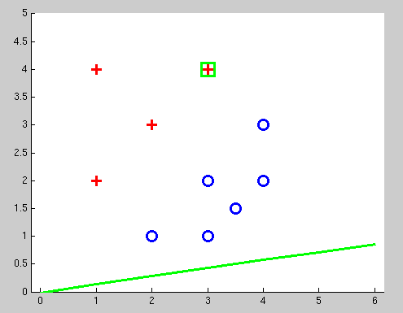
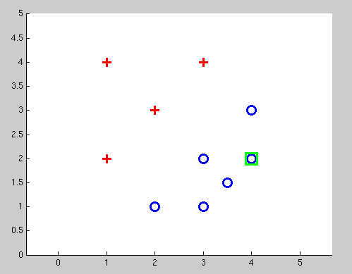
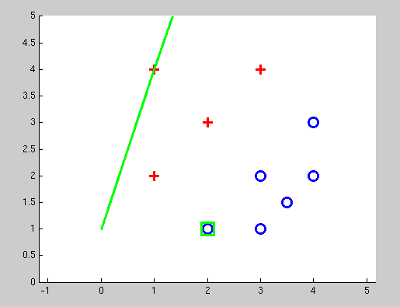
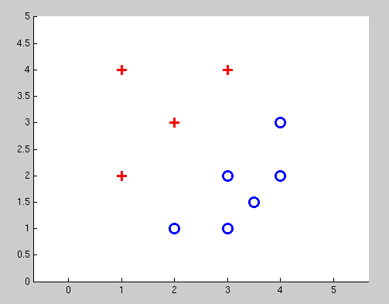
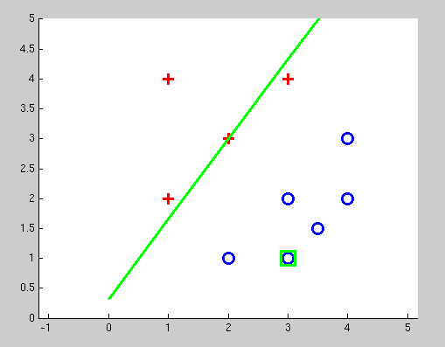
Examples: Perceptron
Separable Case

Slide 22

Feed-Forward Propagation
In the Neural Network, our journey starting from the input to the output is called the forward direction. The weights entering each node are multiplied with the available value (if input is x feature value, if hidden layer is the value from the sum of previous multiplications entering that node) and bias is added. This multiplication operation is called the “dot product”, and that’s because we’re dealing with vectors.

Slide 23
Feed-Forward Propagation Example
Now we can move on to our numerical example. Let’s go through a simple example and focus on the operations rather than the complexity of the model. There are two input neurons (node), two hidden neurons, and two output neurons. In addition to these, the hidden layer and the output layer contain two biases. Let’s use the “sigmoid” activation function in the hidden layer.
i is abbreviated to represent the input layer
h is abbreviated to represent the hidden layer
o is abbreviated to represent the output layer.

Slide 24
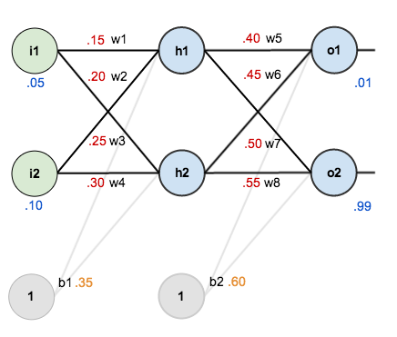
Feed-Forward Propagation Example

Slide 25
Feed-Forward Propagation Example
Let’s calculate h1 first. While doing this, it is seen that there are i1, i2 and b1 nodes entering the h1 node. Therefore:
h₁= W1 * i1 + W3*i2+b1*1
= 0.15* 0.05 + 0.25* 0.10 +0.35 * 1
= 0.3825
outh₁ = 1/1+e^-h1
=1/1+ e^-0.3825
= 0.5944
Then let’s find h2:
h2= W2 * i1 + W4*i2+b1*1
= 0.20* 0.05 + 0.30* 0.10 +0.35 * 1
= 0.39
outh₁ = 1/1+e^-h1
=1/1+ e^-0.39
= 0.5962

Slide 26
Feed-Forward Propagation Example
Now we have calculated our hidden layers. The queue is in the output layer. Let’s start with o1 first:
O1 = (W5 *outh1) + (W7*outh2) + (b2 * 1)
=(0.4* 0.5944) + (0.45* 0.5962) + 0.6*1
=1.1754
outo1=1/(1+e-o1)
=1/(1+e-1.1754)
=0.7480
Finally, let’s calculate o2:
O1 = (W6 *outh1) + (W8*outh2) + (b2 * 1)
=(0.45* 0.5944) + (0.55* 0.5962) + 0.6*1
=1.0882
outo1=1/(1+e-o1)
=1/(1+e-1.0882)
=0.7641

Slide 27
Feed-Forward Propagation Example
Since we have calculated our outputs, it is time to find the loss function value. Let’s say our target values are:
Eo1= 1/2(target-outo1)²= (0.01-0.7480)^2 = 0.2723
Eo2=1/2(target-outo2)²= (0.99-0.7641)^2 = 0.02928
Etotal= Eo1+ Eo2= 0.2723+0.02928 = 0.3016

